Slide 1



SNHU Travel — Sprint Review & Retrospective
By Madison Parker — Scrum Master | ChadaTech Pilot
Travel
.
ThePhoto by PhotoAuthor is licensed under CCYYSA.
Notes:
Introduce yourself, mention roles taken (Scrum Master, Product Owner, Developer, Tester). Set tone: Y2K-professional aesthetic.

Slide 2
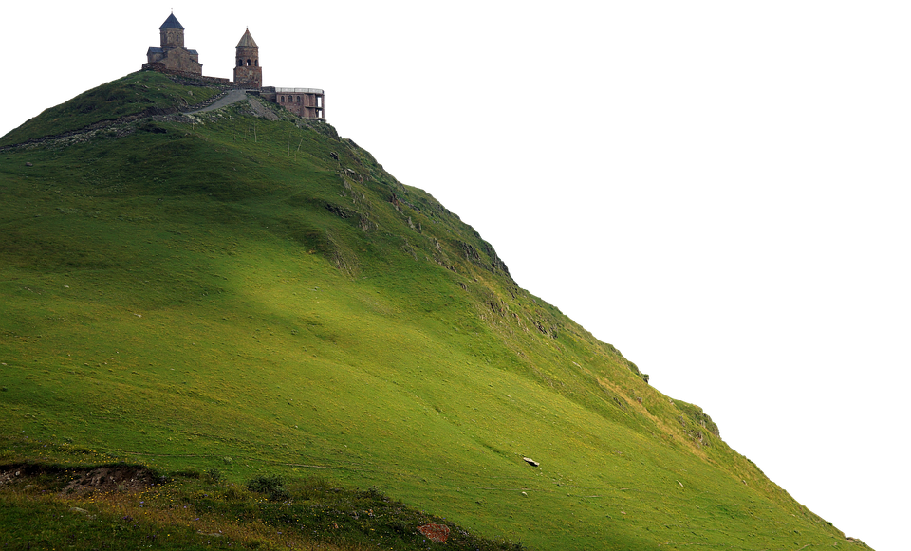
Project Snapshot
• Goal: Build a personalized travel app emphasizing
wellness and cultural immersion.
• Focus Destinations: Ireland, Vietnam, Maine, Germany, Japan.
• Approach: Scrum-Agile with iterative sprints and
continuous stakeholder feedback.
Notes:
Summarize objectives and why Agile fit this project's evolving scope.

Slide 3
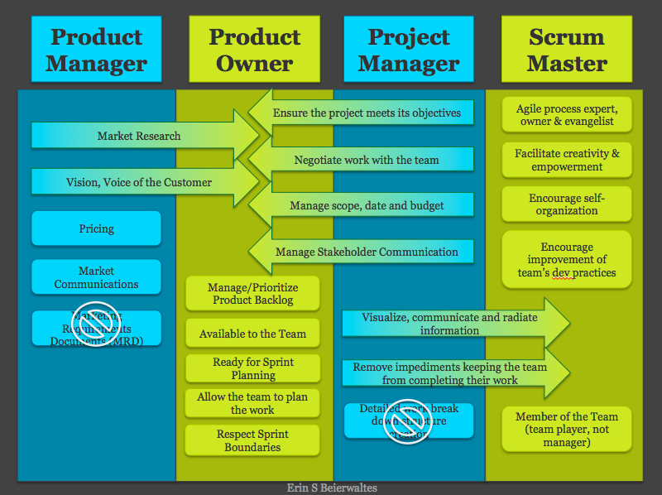
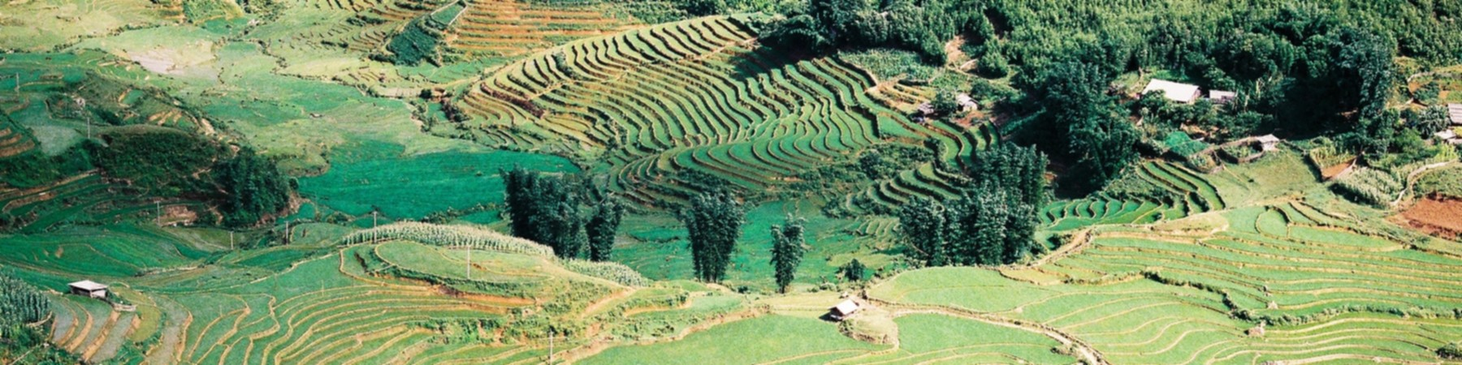
Scrum Roles — Practical Impact
• Scrum Master: Facilitated ceremonies, removed impediments.
• Product Owner: Re-prioritized backlog for wellness-focused features.
• Developer: Built destination modules and recommendation algorithms.
• Tester: Ensured usability and performance across devices.
ThePhoto by PhotoAuthor is licensed under CCYYSA.
ThePhoto by PhotoAuthor is licensed under CCYYSA.
Notes:
Give a short example of switching roles and how that informed decisions.

Slide 4



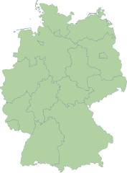
How the SDLC Operated in Sprints
Sprint 1 — Homepage/UX
Sprint 2 — Top Five Destinations module
Sprint 3 — Performance, images,
and wellness filters
Review → Feedback → Iterate
ThePhoto by PhotoAuthor is licensed under CCYYSA.
.
Notes:
Emphasize iterative delivery and improved time-to-feedback.

Slide 5


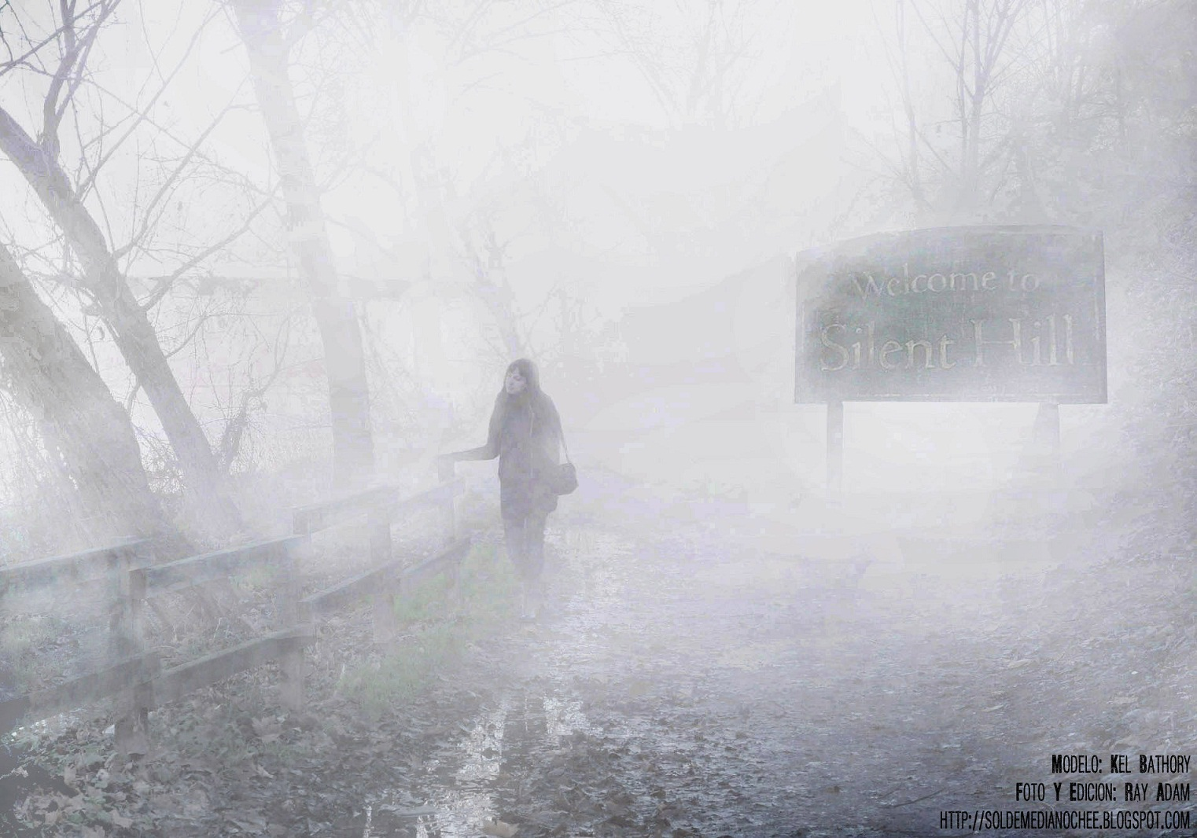
Adapting to Change: Wellness Pivot
• Client shifted focus to wellness mid-project.
• Action: Emergency backlog refinement; new filters added
(onsens, spas, coastal retreats).
• Outcome: Faster alignment with user needs and preserved velocity.
Fun Fact: Did you know Silent Hill was inspired by Maine Costal towns like Bangor?
.
Notes:
Contrast with how waterfall would have delayed response to change.

Slide 6



Communication — The Glue
• Daily stand-ups for alignment
• Slack & Trello for async decisions
• Clear written queries reduced rework (example included in doc)
ThePhoto by PhotoAuthor is licensed under CCYYSA.
ThePhoto by PhotoAuthor is licensed under CCYYSA.
ThePhoto by PhotoAuthor is licensed under CCYYSA.
ThePhoto by PhotoAuthor is licensed under CCYYSA.
Notes:
Mention the sample message from Tester to PO and why precise asks help.

Slide 7



Tools & Ceremonies
JIRA — Story tracking & velocity
Kanban boards — Visual flow
Sprint Review & Retrospective — Stakeholder validation
+ continuous improvement
ThePhoto by PhotoAuthor is licensed under CCYYSA.
ThePhoto by PhotoAuthor is licensed under CCYYSA.
ThePhoto by PhotoAuthor is licensed under CCYYSA.
Notes:
Highlight retrospectives as a high-leverage practice.

Slide 8

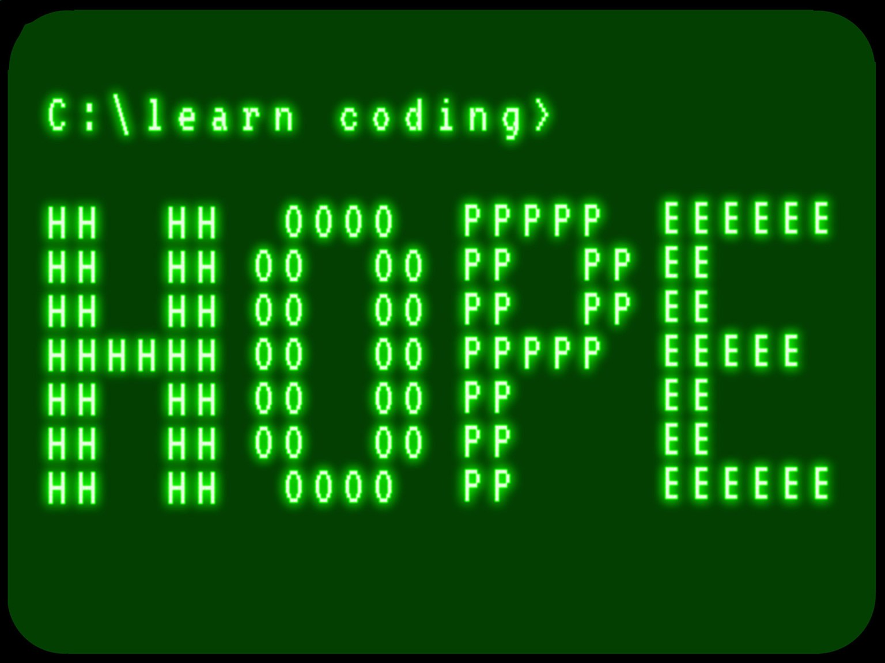
Pros & Cons of Agile for SNHU Travel
Pros:
• Flexibility
• Early feedback
• Higher quality
Cons:
• Scheduling across time zones
• Less long-form documentation
Recommendation: Agile for similar exploratory projects.
ThePhoto by PhotoAuthor is licensed under CCYYSA.
Notes:
Tie pros/cons back to specific incidents in the project.

Slide 9
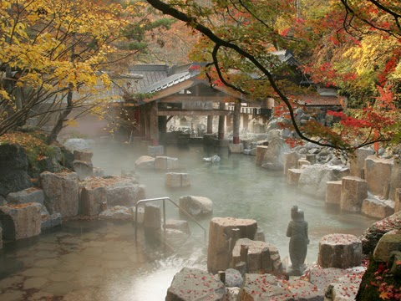
Personal Reflection & Vision
• Favorite module: Japan hot springs — design + UX storytelling
• Takeaway: Empathy-driven design and servant leadership
• Future: Apply learnings to scale Agile across ChadaTech.
• Popular destinations that many individuals e
ThePhoto by PhotoAuthor is licensed under CCYYSA.
Notes:
Add excitement about visiting Japan post-graduation and how it inspired the onsens module.

Slide 10
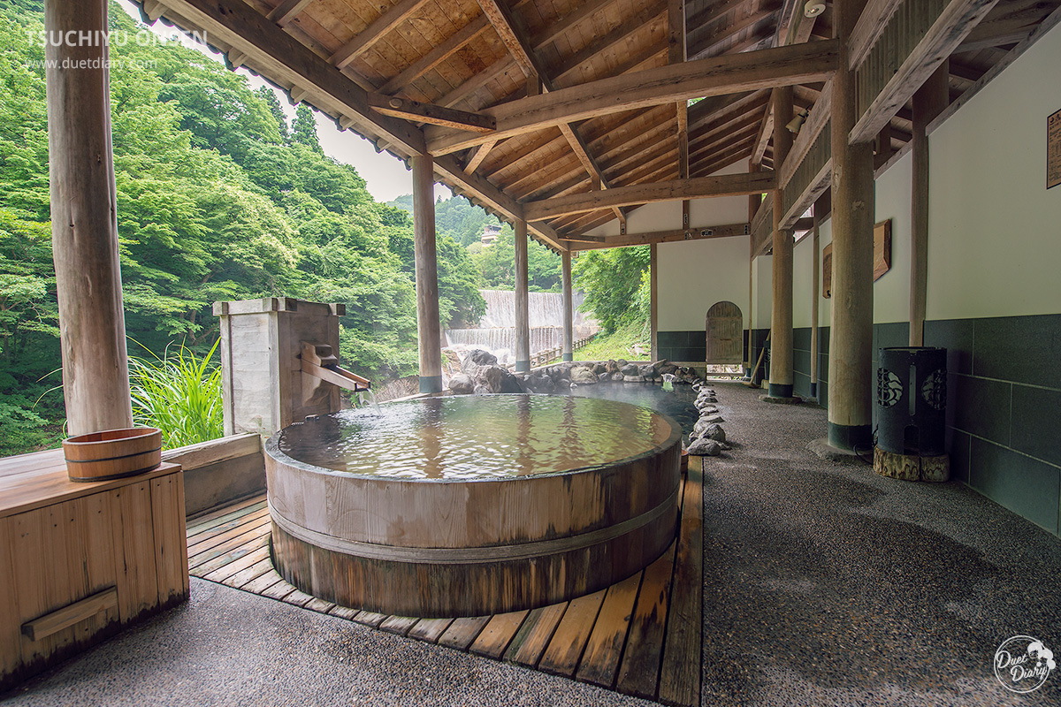
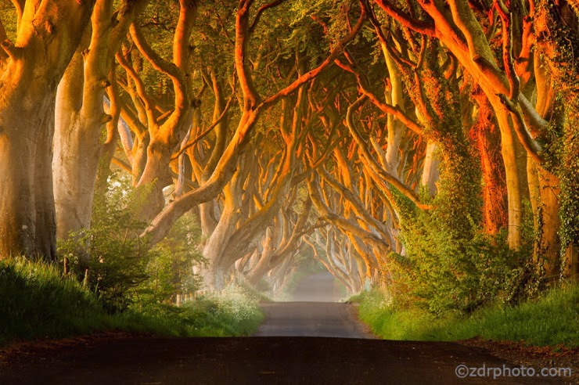

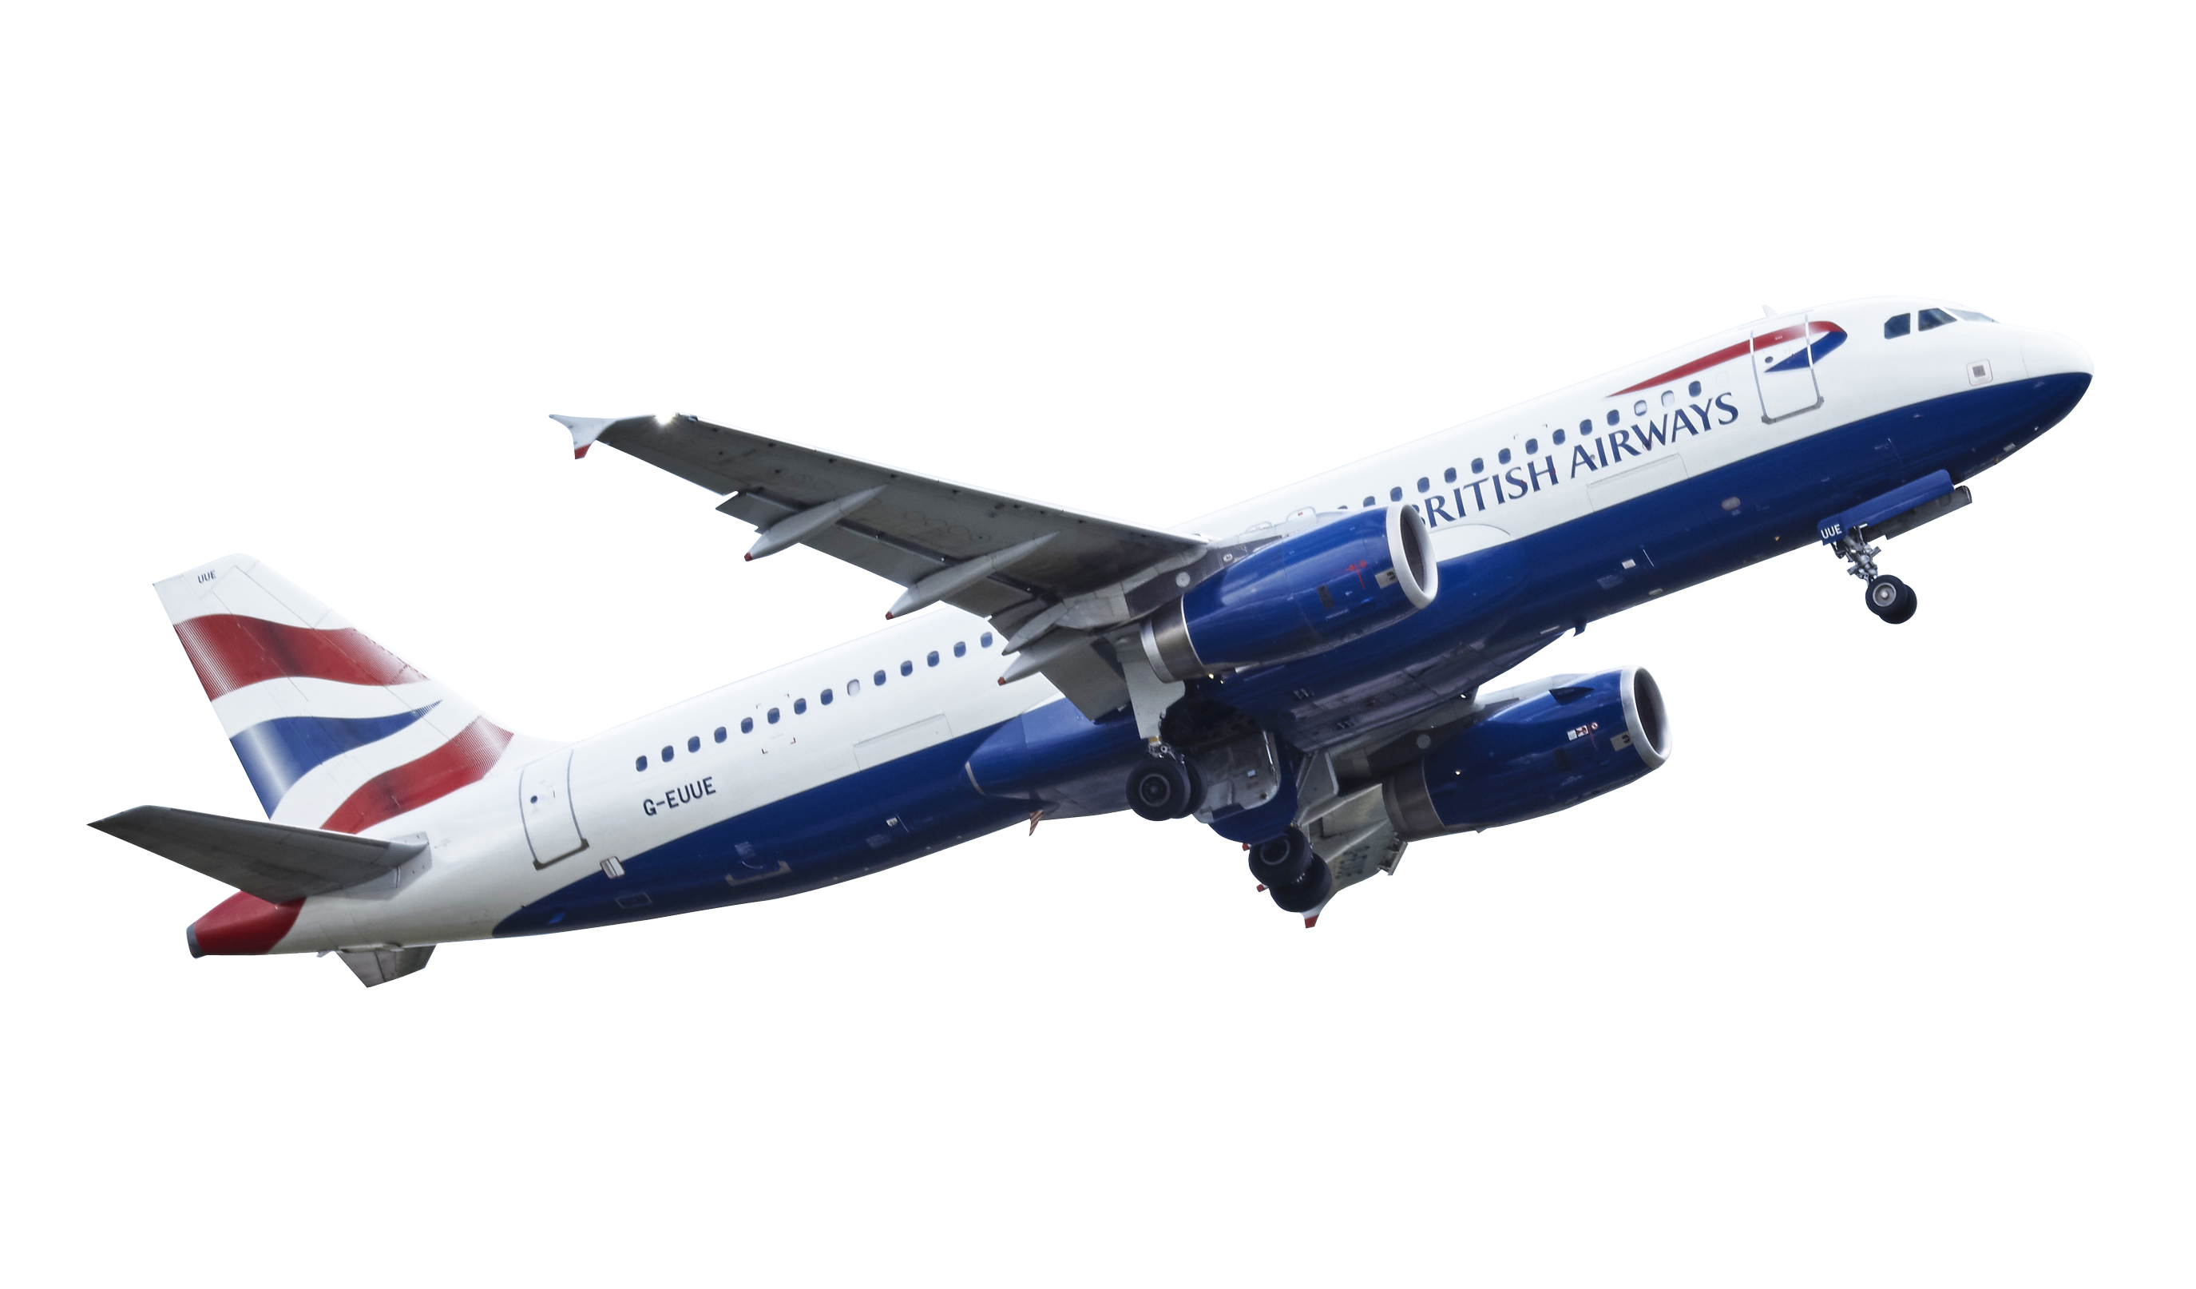
Conclusion & References
ThePhoto by PhotoAuthor is licensed under CCYYSA.
ThePhoto by PhotoAuthor is licensed under CCYYSA.
ThePhoto by PhotoAuthor is licensed under CCYYSA.
Agile enabled rapid adaptation and high-quality delivery.
References:
Beck et al., 2001; Cobb, 2015; Highsmith, 2020; Rigby et al., 2016; Schwaber & Sutherland, 2020
ThePhoto by PhotoAuthor is licensed under CCYYSA.
.
Notes:
Thank leadership and suggest next steps for piloting Agile more broadly at ChadaTech.

